Slide 1
Internship Project:
Monitoring Rapid Temperature Cycle in Liquid
05 April 2023
PT TDK ELECTRONICS INDONESIA
TPS Business Group • BT TPS HR
Batam, Indonesia

Slide 2
Project Team
I Made Aditya Rama P
Internship Politeknik Elektronika Negeri Surabaya - NIM: 4120600021
Major - Mechatronics Engineering
Sander Antonius Balisa Internship Politeknik Elektronika Negeri Surabaya – NIM: 2120600053 Major – Electronic Engineering
Project Mentor
Head of department : Mr. Mahesh Nair
Mentor : Mr. Syaifudin Muchlis
Project supervisor : Mr. Indratno Sukmandaru

Slide 3

Project Objectives :
The purpose of this project is to implement industrial revolution 4.0 digitalization for RTC (Rapid Temperature Cycling in Liquids) system. This project is an improvement project compared existing system.

Slide 4
List of project benefits:
Categories | Existing System | Improvement Project
Capabilities | Up to 195 samples | Up to 3120 samples
DMM Connections | 1 DMM | Up to 16 DMM
Interval data collect | 1 PLC Configuration (25 second/39 samples) 0.641s | 0.01 PLC Configuration (2.5 second/39 samples) 0.064s
Real-time Graph | No | Yes
Output | Text File (*.txt) | Excel File (*.xlsx) + Table Format View + Auto Graph
Bath Temperature Monitoring | No | Yes

Slide 5
List of project benefits:
Categories | Existing System | Improvement Project
Data Storage | Text File (*.txt) | SQL Server Database
Sampling Schedule | Static | Dynamic
Output | Text File (*.txt) | Excel File (*.xlsx) + Table Format View + Auto Graph
GUI | Static | Dynamic (Customizable)
Alarm Alert | No | Yes
Email Notification | No | Yes
Hardware Settings | Non-Configurable | Configurable

Slide 6
Timeline and Action
Work schedule planning | PIC | TIMELINE PROJECT MONITORING CHAMBER
 |  | January |  |  |  | February |  |  |  | March
 |  | 1 | 2 | 3 | 4 | 1 | 2 | 3 | 4 | 1 | 2 | 3 | 4
observation of how the machine works | Aditya & Sander
thermocouple data collection | Aditya
Create desktop applications and integration the data thermocouple and Digital Multimeter Data | Sander
installation of the thermocouple device on the machine | Aditya
Troubleshooting | Aditya & Sander
Finished | Aditya & Sander

Slide 7
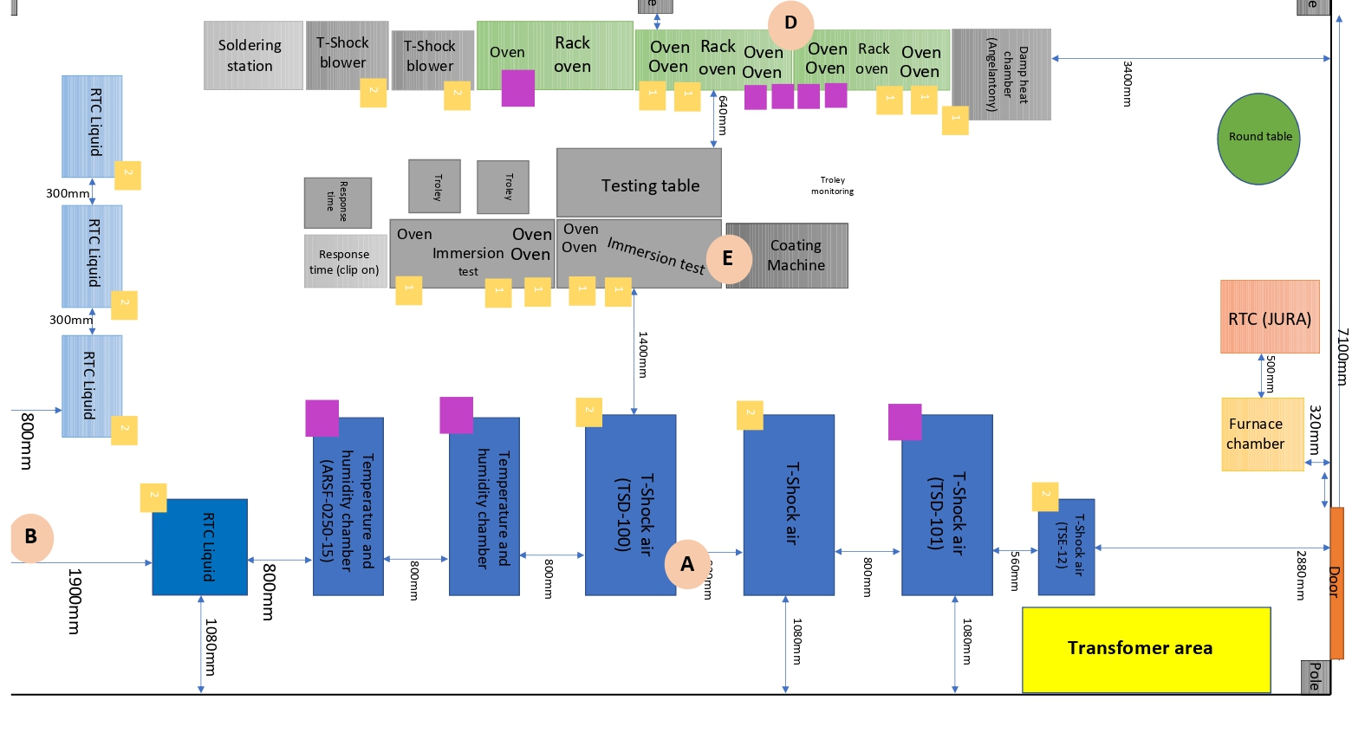
Machine layout
Monitoring Area

Slide 8
Requirement
Hardware
No | Name | Brand / Type | Qty | Unit
1 | Module for thermocouple (8 thermocouple) | Advantech | 1 | Pcs
2 | Thermocouple type-K |  | 6 | Pcs
3 | Digital Multi meter Module | Keithley | 1 | Pcs
4 | Digital Multi meter |  | 1 | Pcs
4 | GPIB Cable |  | 1 | Pcs
5 | Personal Computer |  | 1 | Pcs

Slide 9
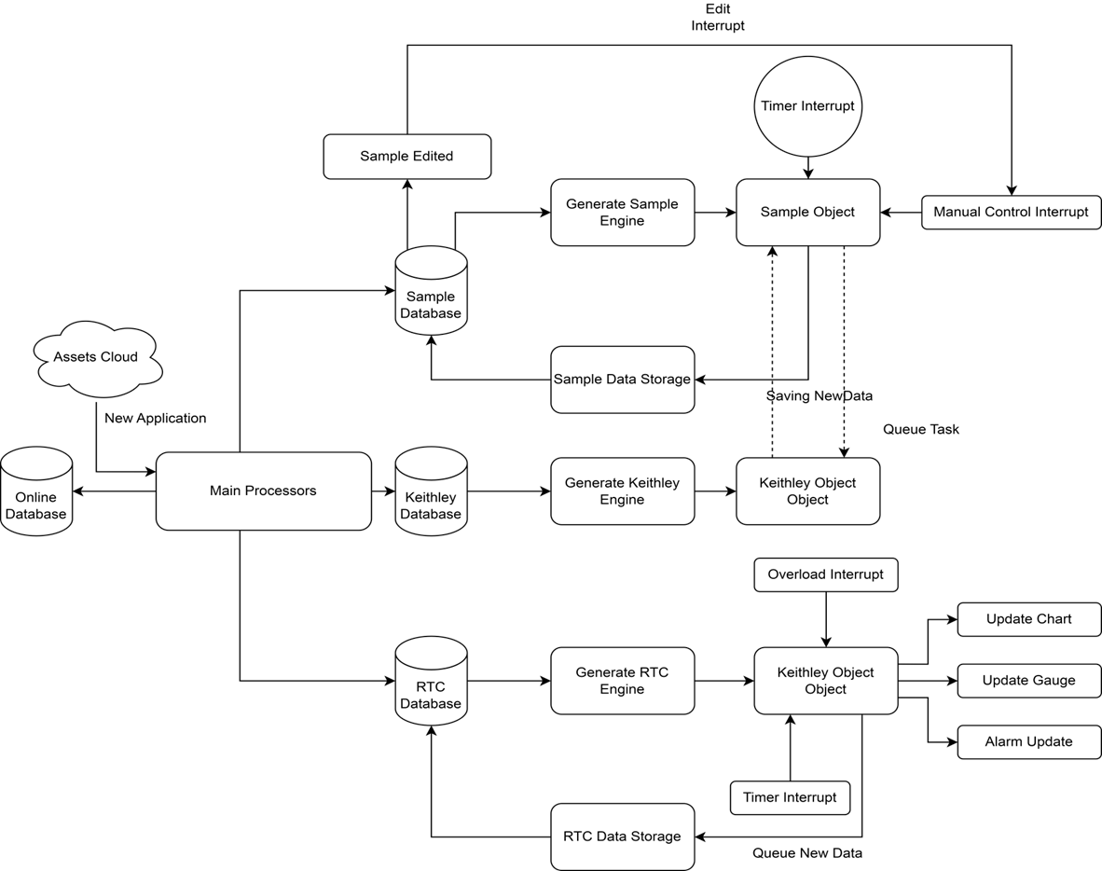
Schematic Rapid Temperature Cycling in Liquid

Slide 10
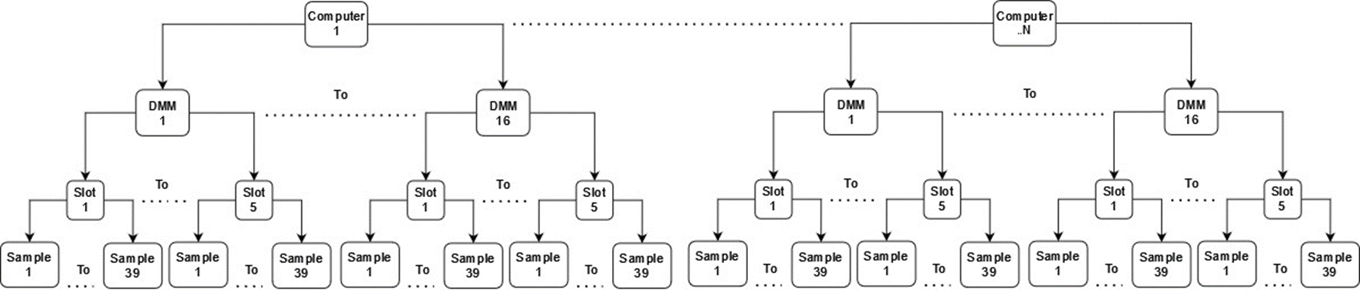
Maximum collected samples
39 samples x 5 slots x 16 DMM = 3.120 samples
And more N computer….

Slide 11
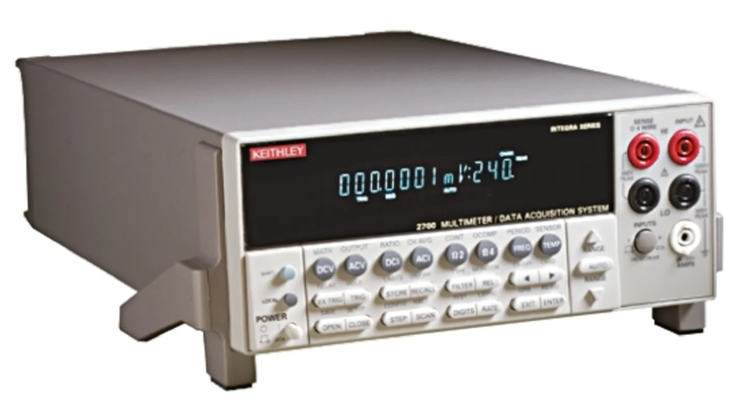
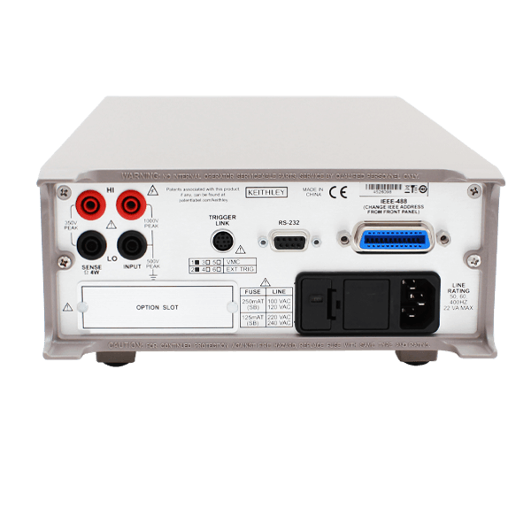
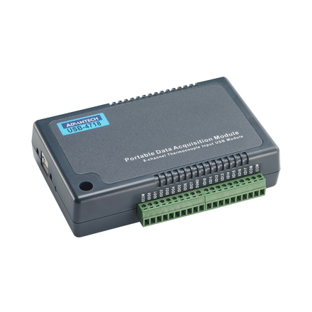
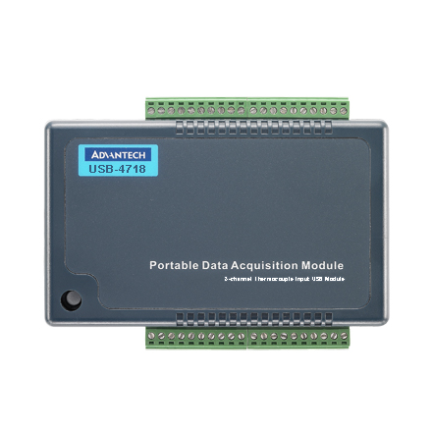
Hardware Components
Front
Back
A Digital Multi mater module used for data acquisition, switching ,data logging, for sampling data on sensor
Front
Back
A thermocouple module used for reading data analog on sensor and convert to digital such as temperature.

Slide 12
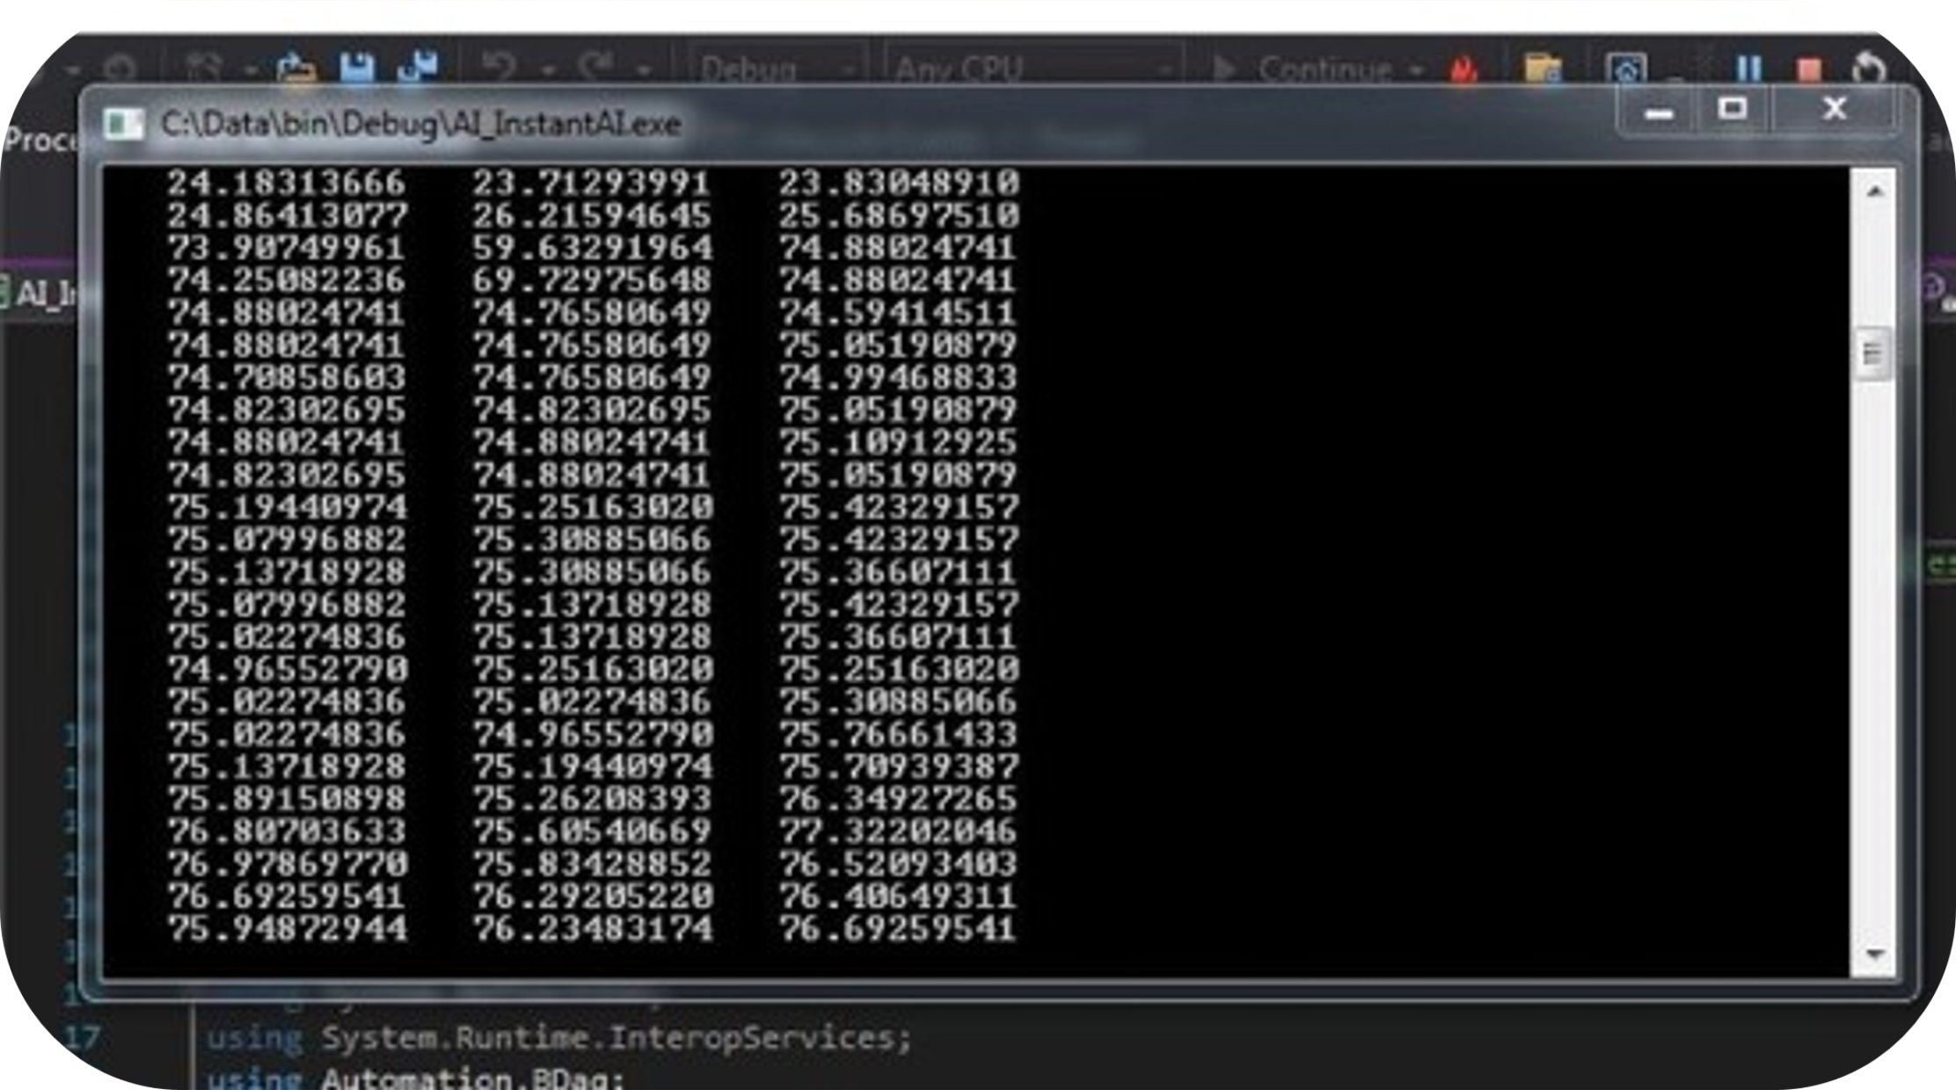
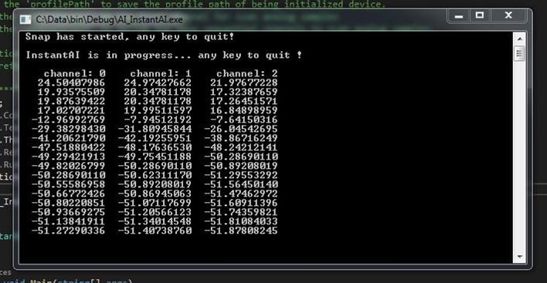
Thermocouple Module for Data Collection
Hot Temperature bath
Cold Temperature bath

Slide 13
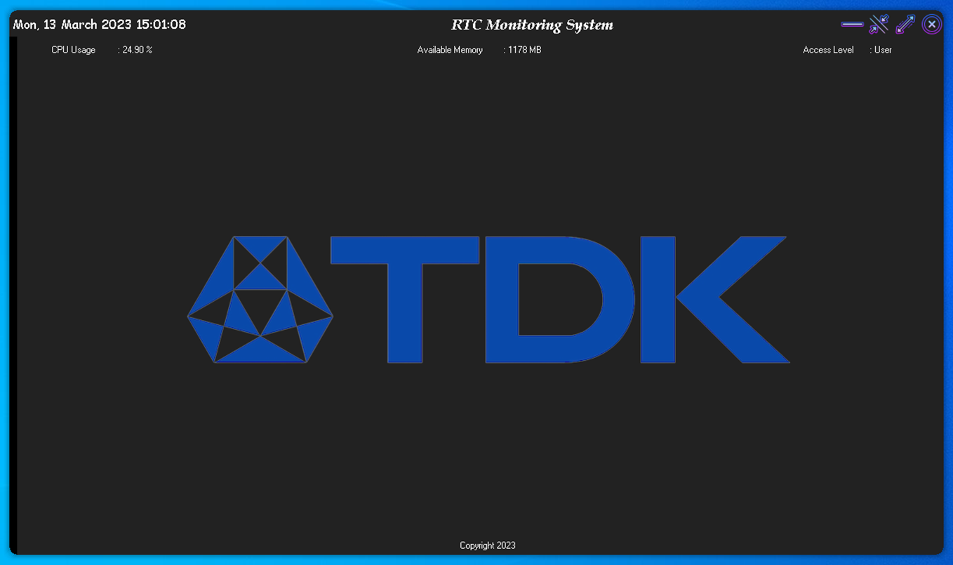
1. Welcome screen
Application User interface

Slide 14
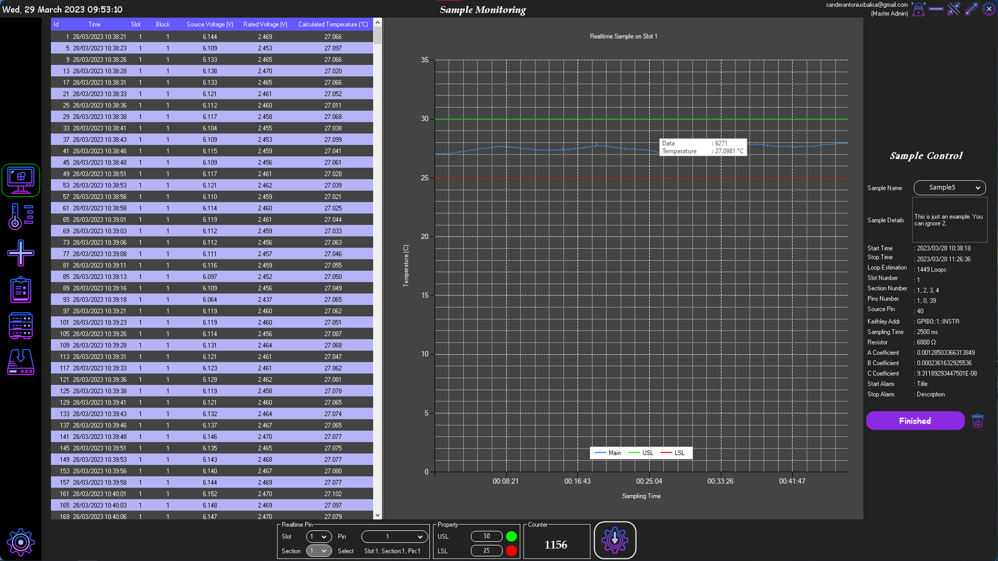
2. Voltage Realtime Monitoring
Application User interface
Detail measurement data
Graphic chart area.
Realtime data will shows following mouse cursor
Sample Parameters

Slide 15
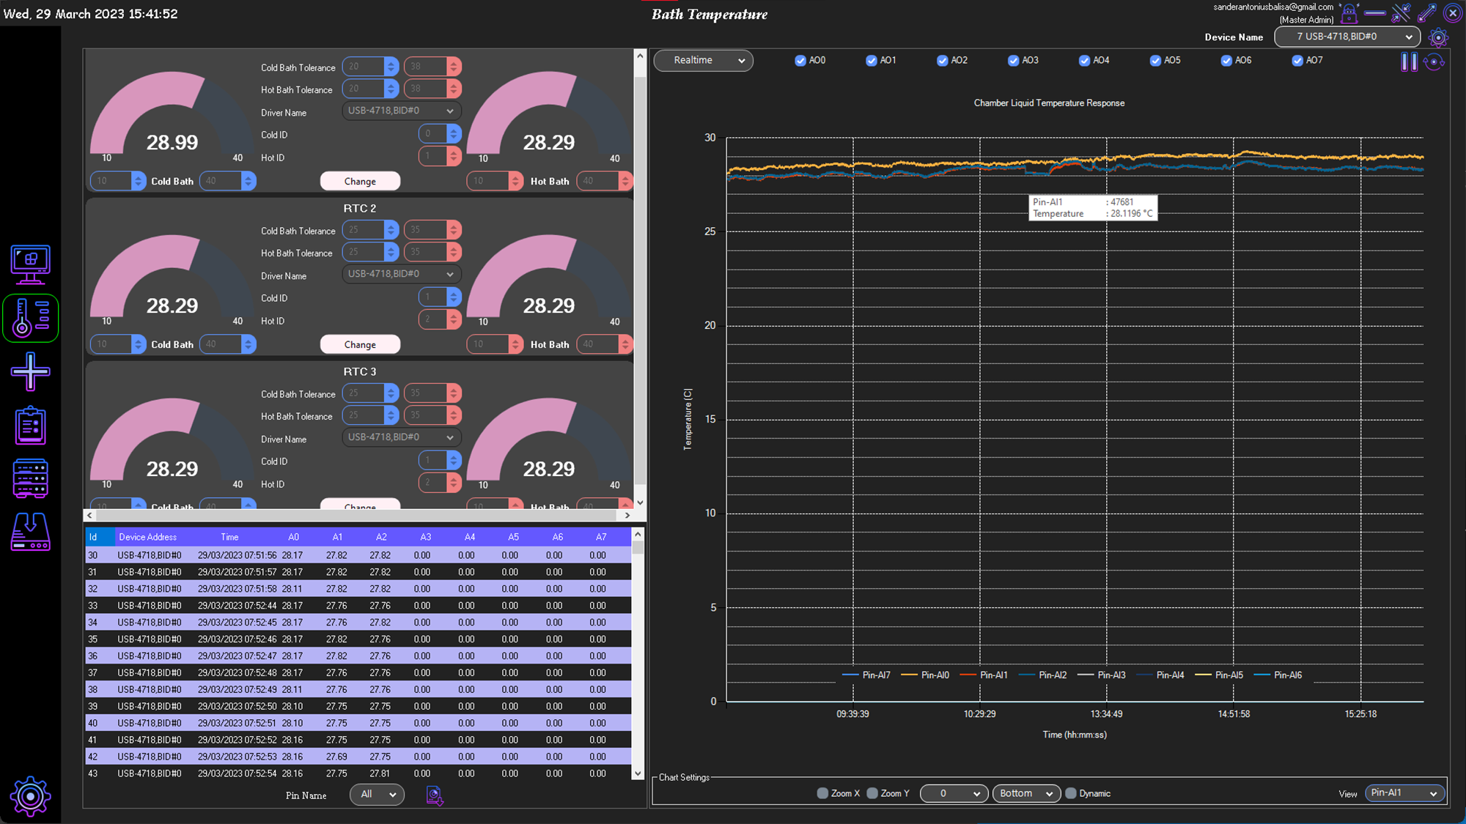
3. Temperature Realtime Monitoring
Application User interface
Option pins for thermocouple module
Menu Bar
Live conditions of RTC Involve temperature, max temperature, devices, number of RTC
Graphic chart area.
Real-time data of thermocouples

Slide 16
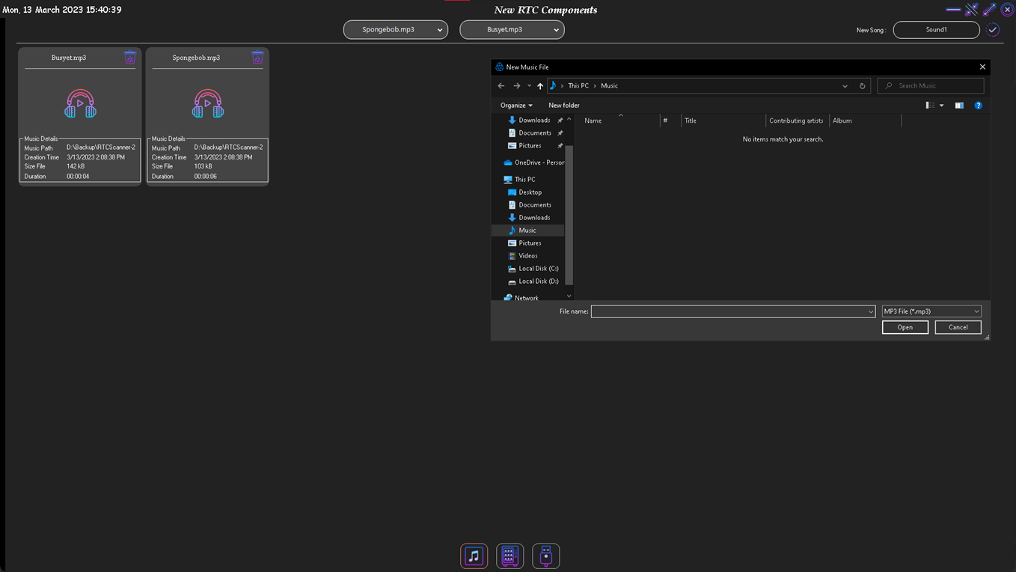
4. Alarm option and can change the sound of alarm
Application User interface
File of the alarm
Fill the alarm file by the directory windows
Assets Menu

Slide 17
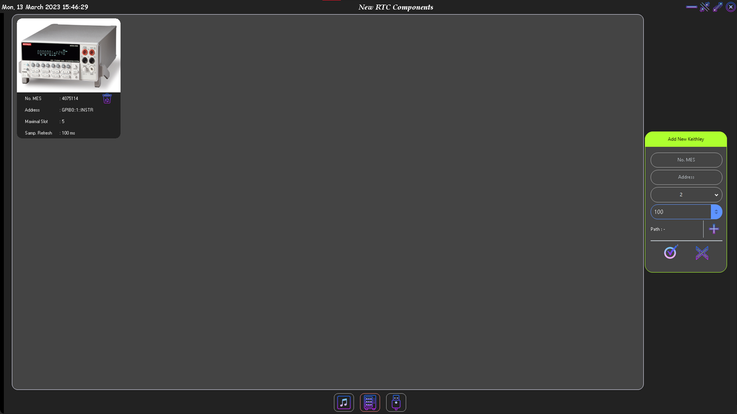
5. Assets Menu Quantity of Digital Multimeter
Application User interface
Digital Multimeter listing file
Applying Digital Multimater and additional mesh number.

Slide 18
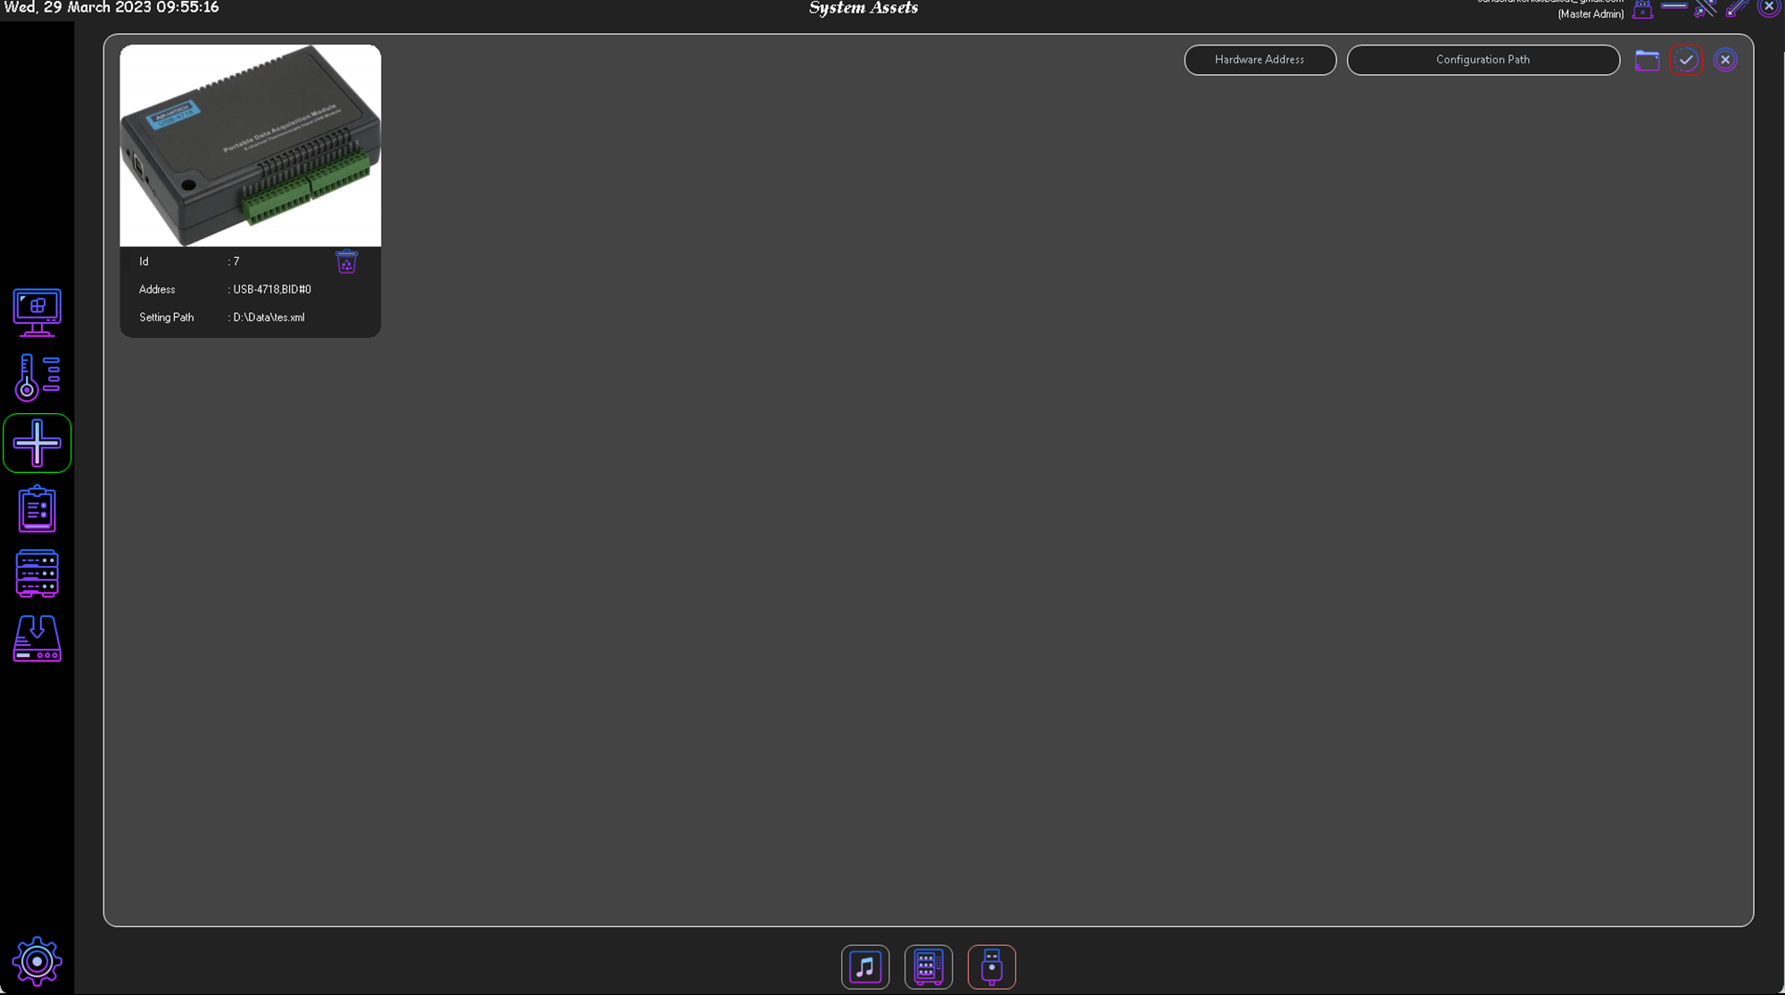
6. Assets Menu Quantity of Thermocouple Module
Application User interface
Modules thermocouple
listing file
Modules applying data source, configuration path.

Slide 19
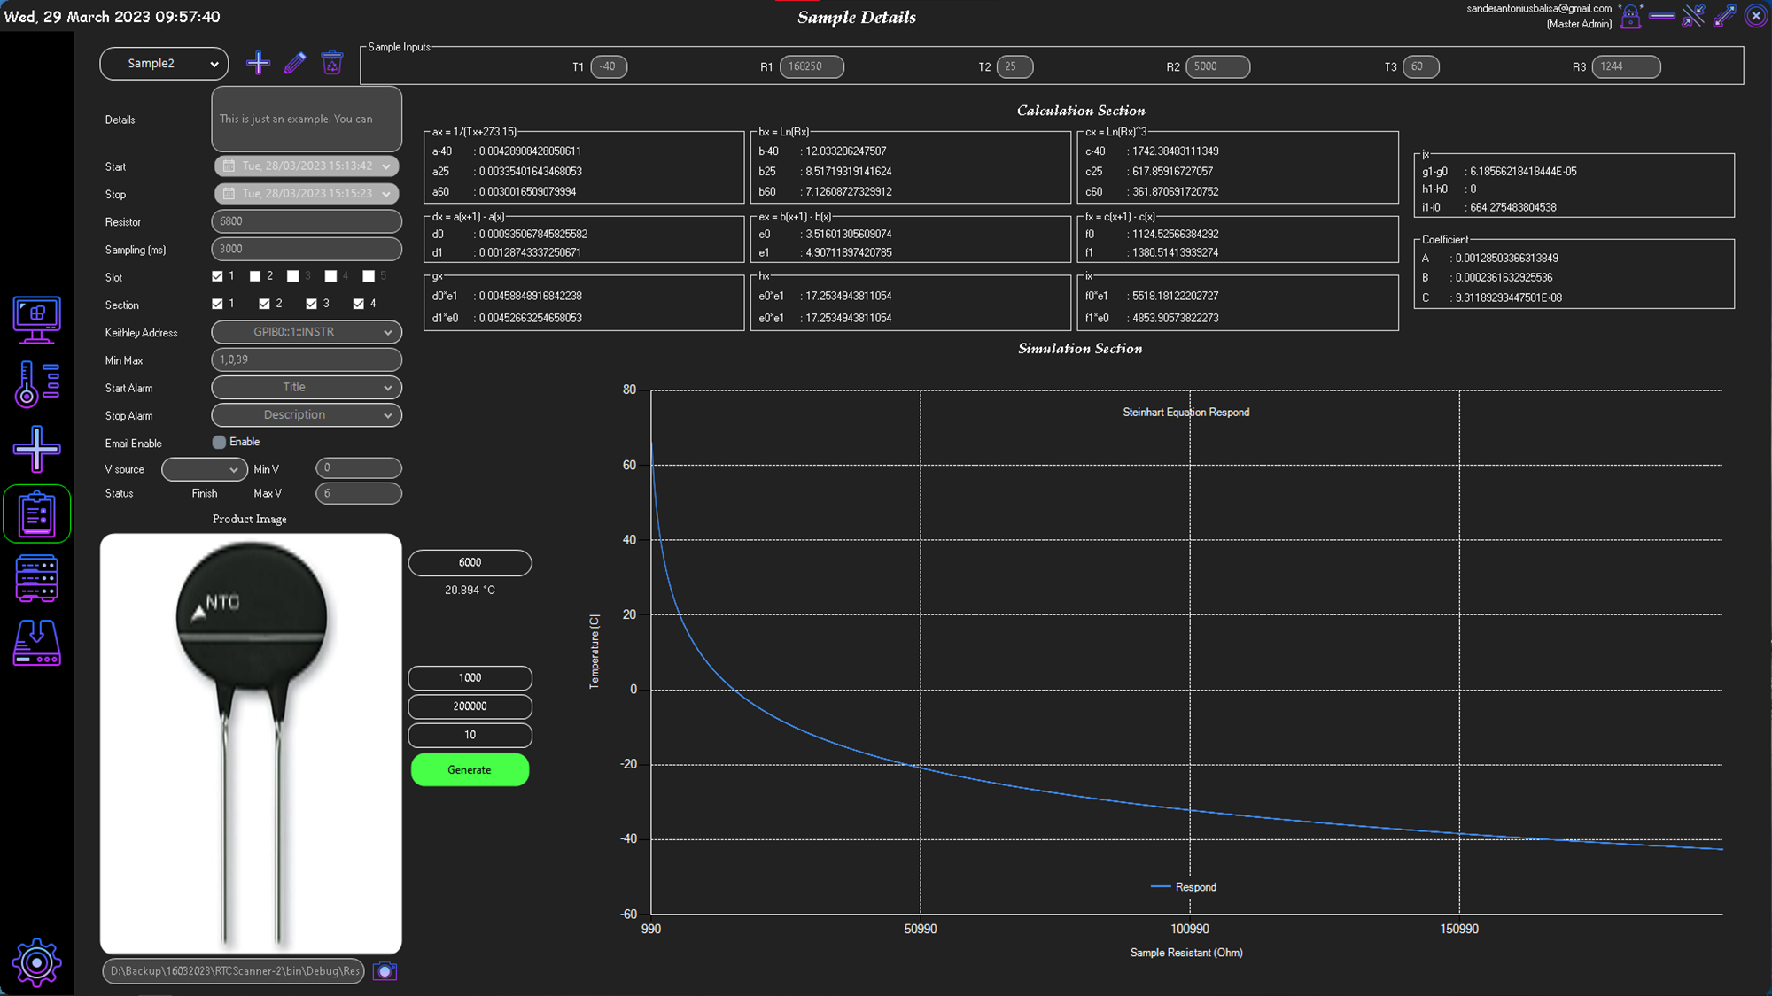
7. Menu of Equation
Application User interface
Calculation section the samples
Detail of the samples it can read all of information
Auto create graph chart by the samples

Slide 20
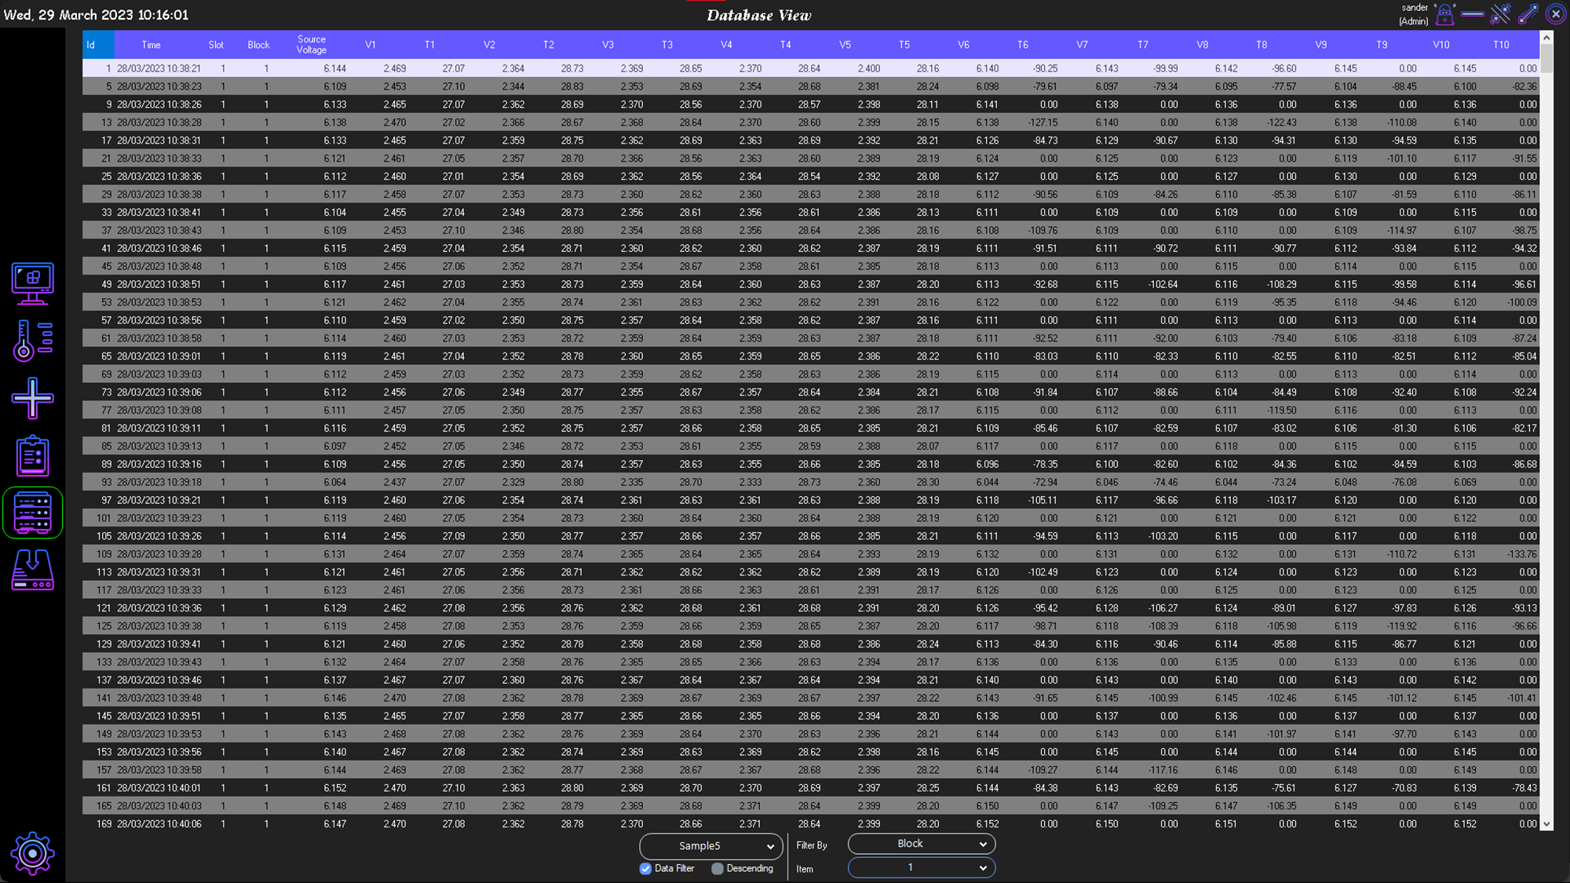
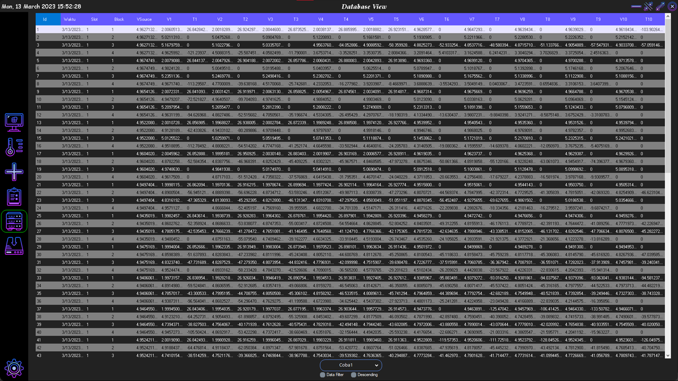
8. Database View Menu
Application User interface
Fill of measurement in database

Slide 21
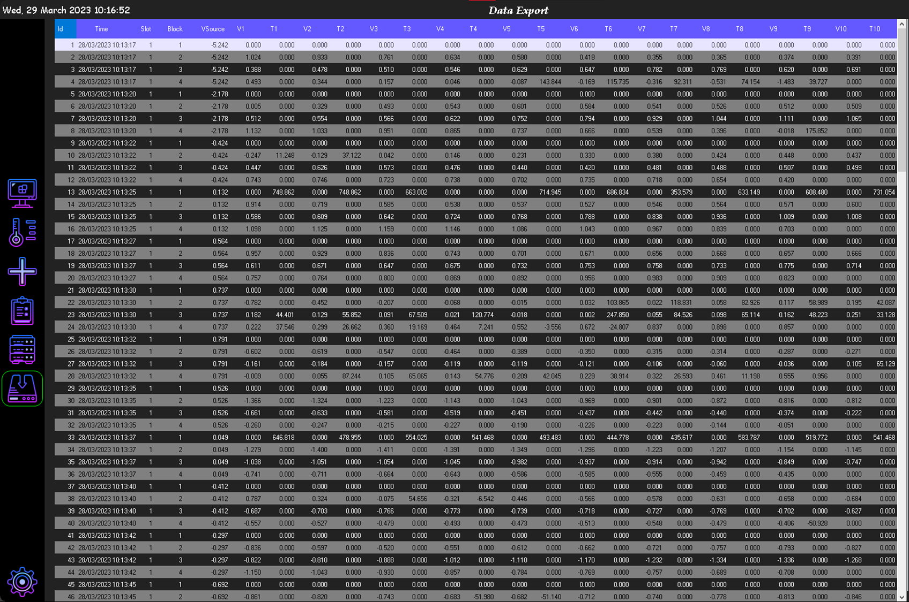
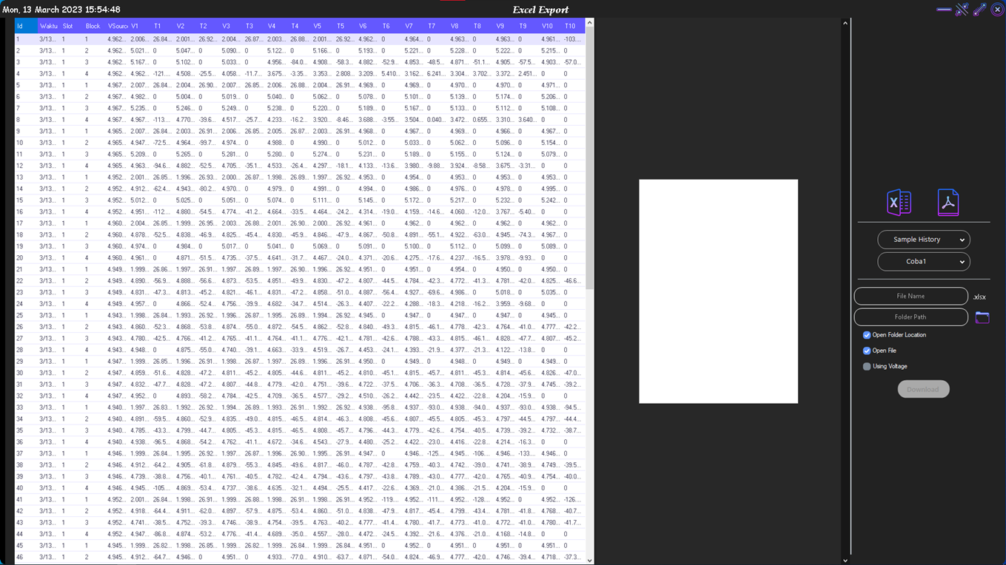
9. Export Menu
Application User interface
Data view before exporting
Export option setting type file (.xlxs) or pdf, and setting the saving directory.

Slide 22
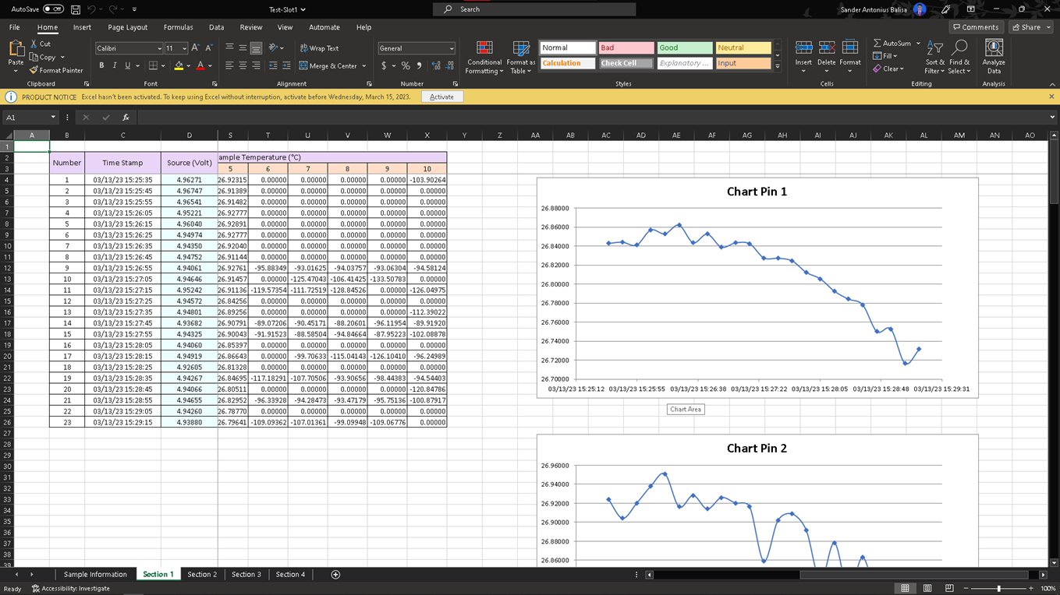
10. View data result in excel
Application User interface
Table view after exporting file
Automatic create the chart by table

Slide 23
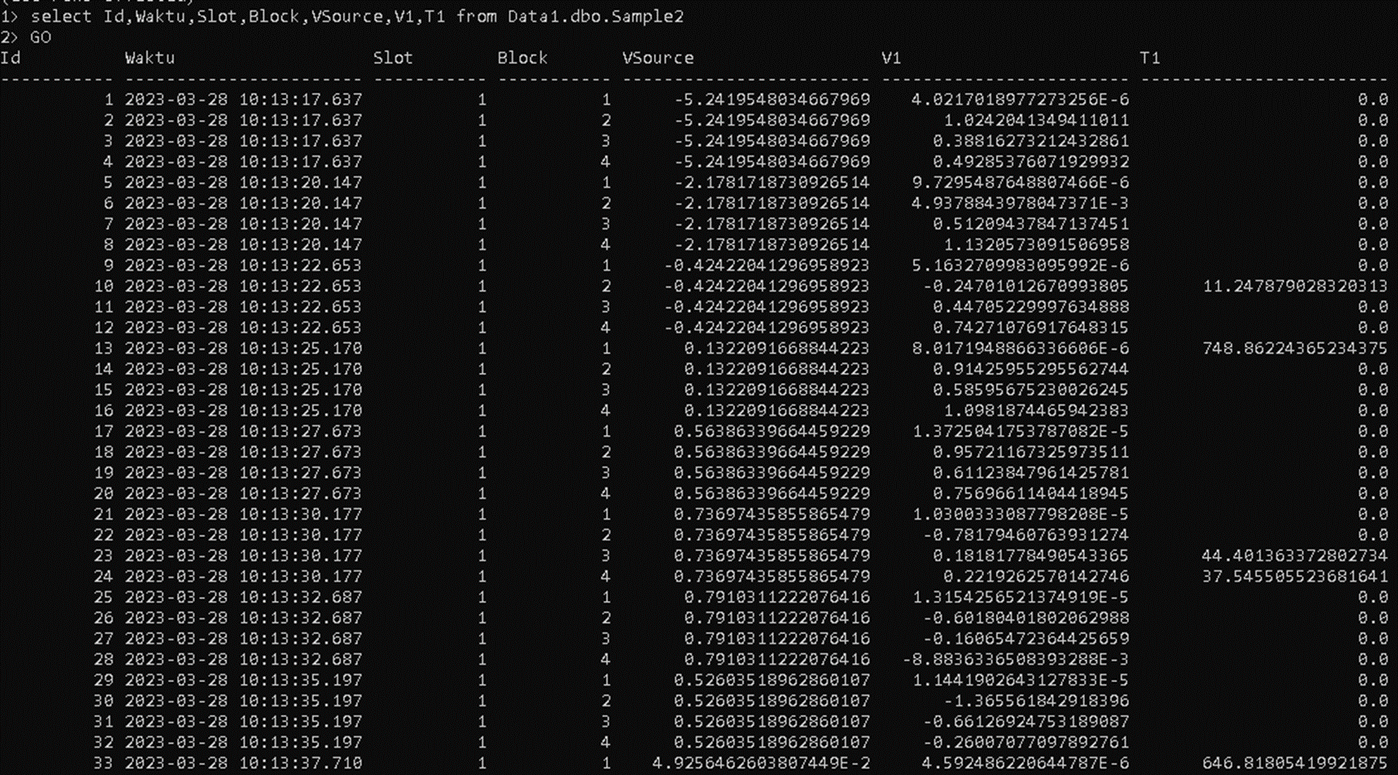
11. Database View by terminal
Application User interface

Slide 24
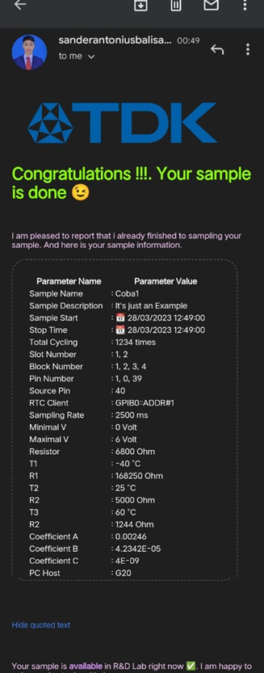
12. Email Notification
Application User interface
Information about samples

Slide 25
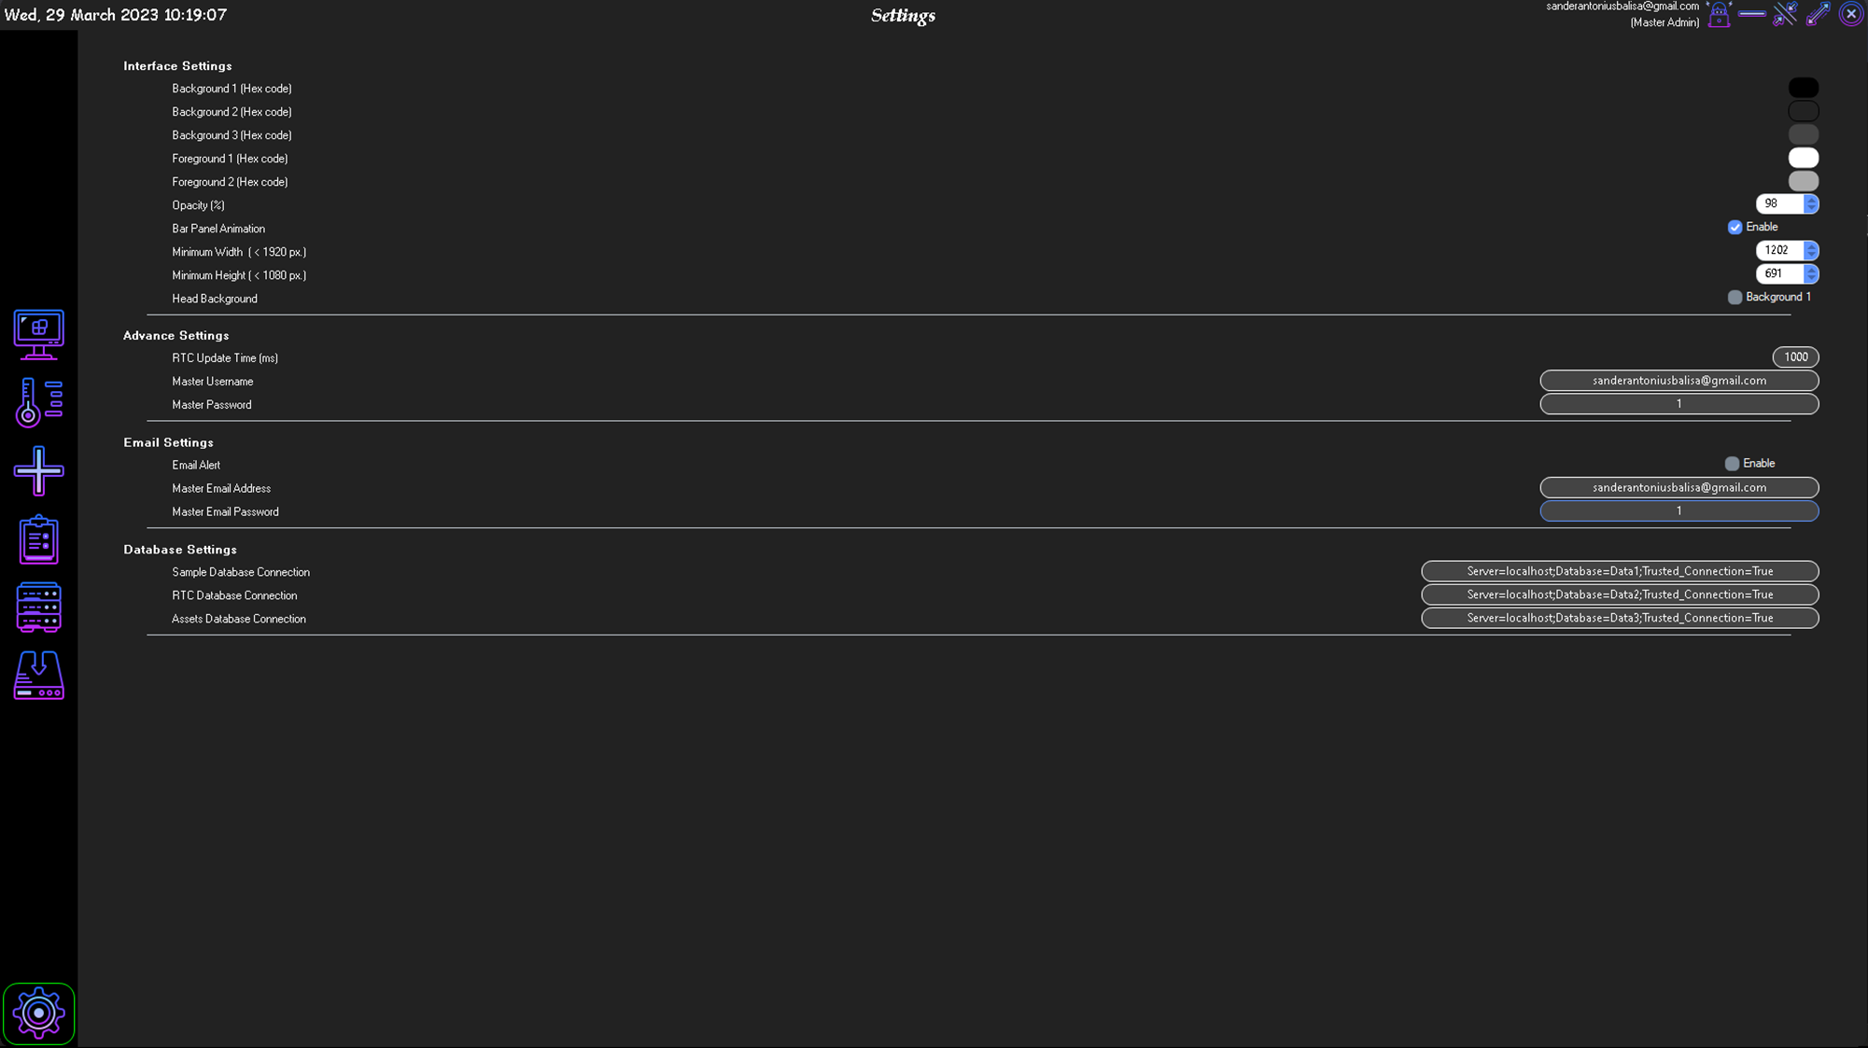
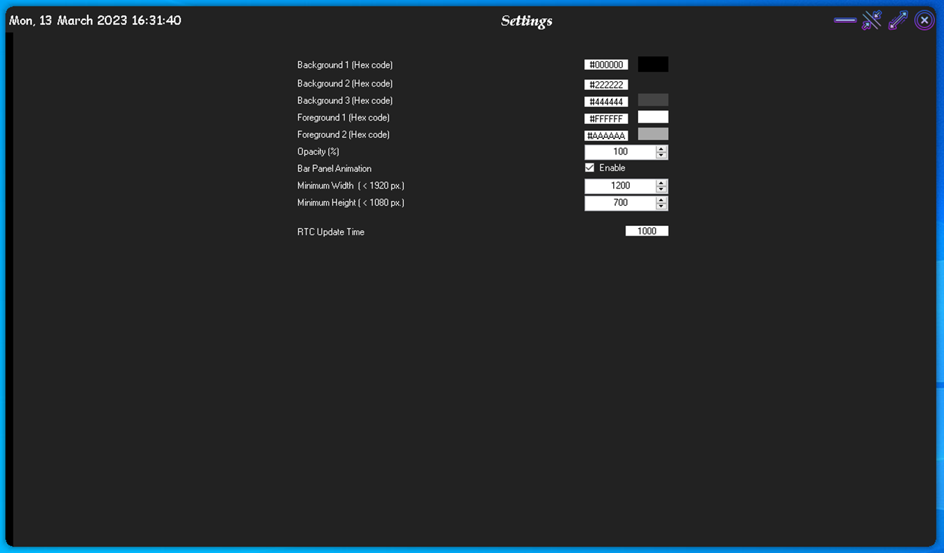
12. Change User Interface color setting
Application User interface
Setting the user interface
Setting for account and RTC update
Setting for email notification
Setting for database RTC, Asset, Database

Slide 26
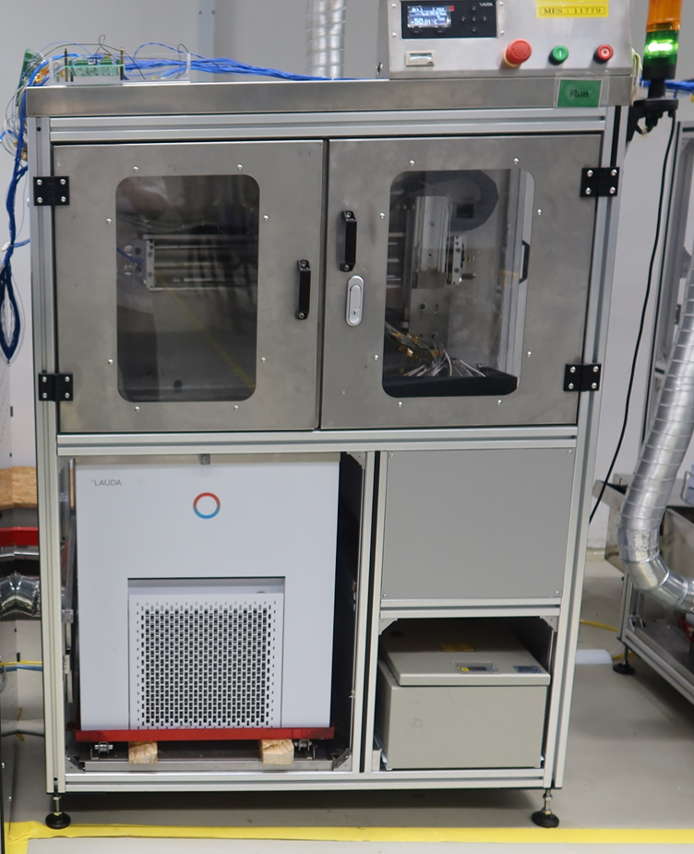
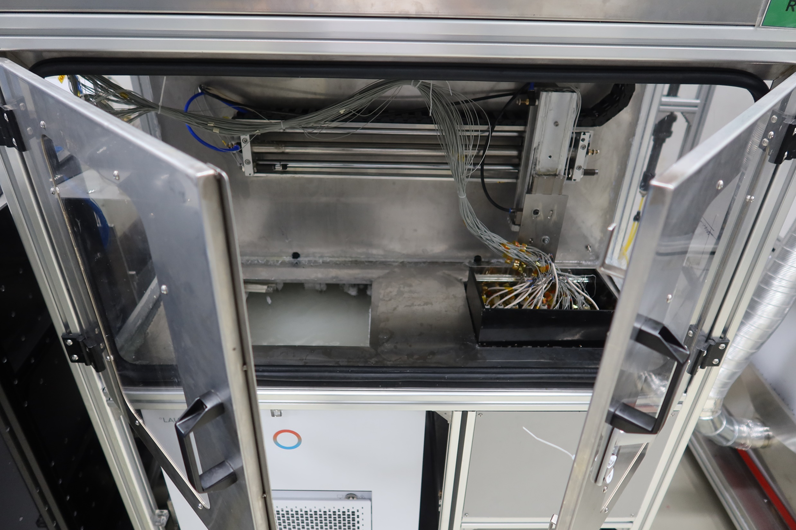
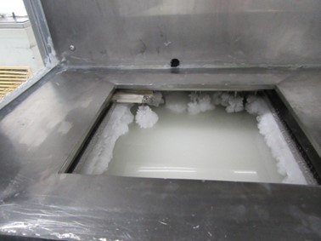
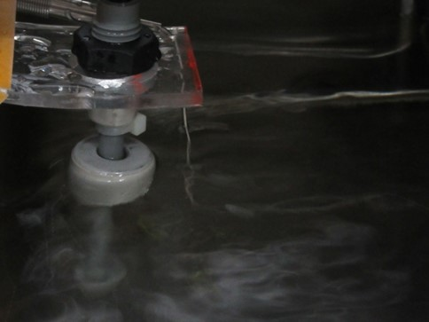
Installation
Hardware
View of RTC machine on front
View in RTC within Cold Temperature
View in RTC with Hot Temperature
View of RTC machine between bath

Slide 27
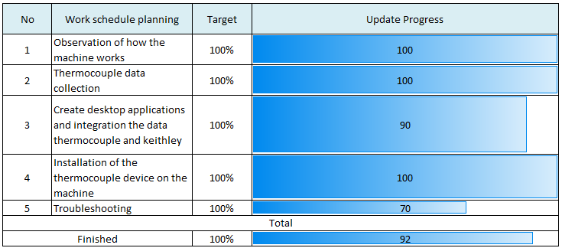
Progress Update

Slide 28
Conclusion
Monitoring RTC (Rapid Temperature Cycling) Liquid in the
Research and Development Lab
Monitoring Temperature in real-time.
Graphical monitoring of the temperature.
Feature :
Monitoring Voltage
Auto create excel file (.xlsx).
Auto graph voltage in excel file
Alarm System

Slide 29
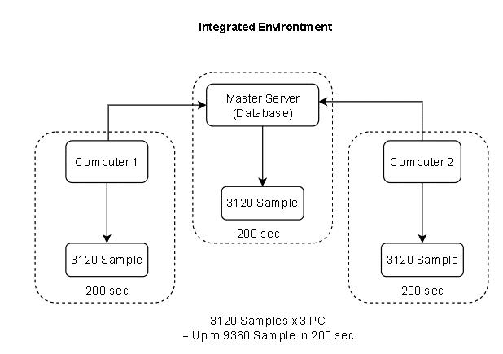
Possibility
(16 DMM * 5 slots) * 2.5 sec sampling = 200 sec
(16 DMM * 5 slots) * 39 sample
= 3.120 samples

Slide 30
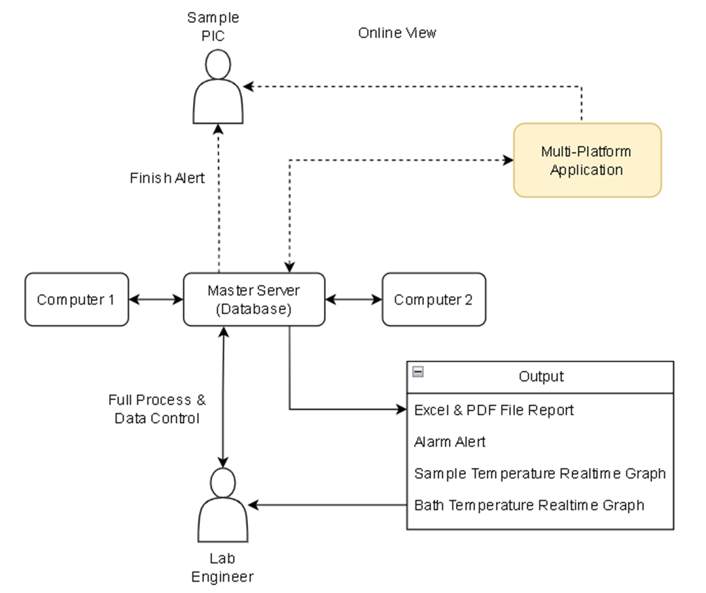
Possibility

Slide 31
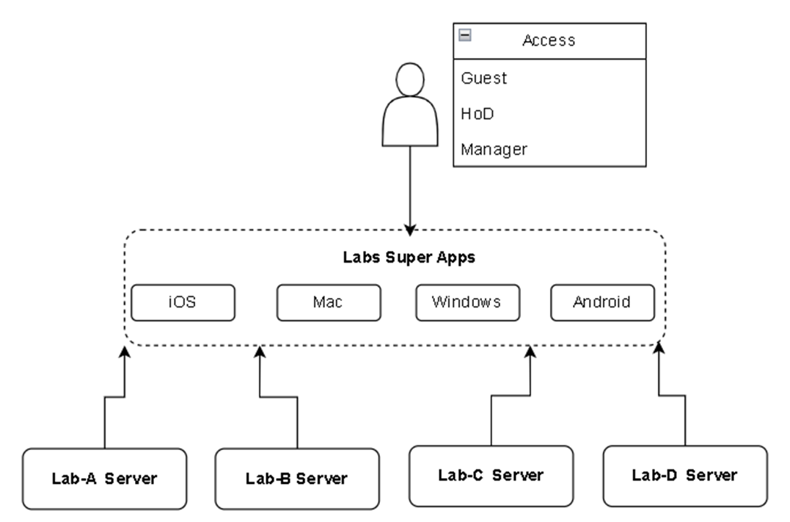
Possibility

